Slide 1
SQL Creating a table
Pradnya dabhade
Class starting sharp at 6:05 pm

Slide 2
Important things to note
Execute the queries whichever you have written – ; Ctrl + Enter
Execute 1 query 1 time only

Slide 3
CREATE DATABASE IN mySQL
CREATE DATABASE databaseName;

Slide 4
USE Database in mySQL
USE databaseName;

Slide 5
Commenting in SQL
1. Single Line comment starts with --
--Select all: SELECT * FROM Customers;
2. Multiline comment starts with /* ends with */
/*Select all the columns of all the records in the Customers table:*/ SELECT * FROM Customers;

Slide 6
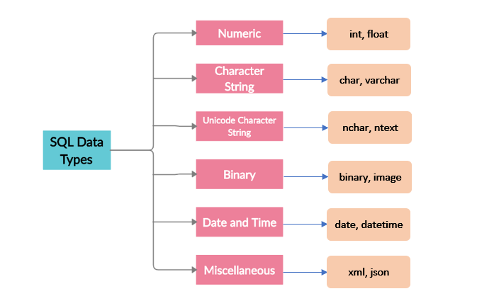
Datatypes in SQL

Slide 7
What is a Data Type?
A data type as the name suggests is the type or category to which the data belongs to. It is an attribute of the data which defines the type of data an object can hold.
In SQL the data type defines the type of data to be stored in each column of the table.
Each column has its own data type. It is important to specify the data type of all columns so that similar values can be added to it.
This means one column can hold only one type of data.
The data type is specified while creating the structure of the table.

Slide 8
Creating table syntax
CREATE TABLE table_name ( column1 datatype, column2 datatype, column3 datatype, .... );
Ex: create table users(
id int,
username varchar(15),
email varchar(50),
age int,
mob char(10));

Slide 9
Insert data in table
INSERT INTO table_name VALUES (value1, value2, value3, ...);
INSERT INTO users
VALUES (1, ‘pradnya', 'test@test.com’, 30, '123456789');

Slide 10
Viewing the table
SELECT * FROM table_name;

Slide 11
Insert multiple values in table
INSERT INTO table_name VALUES (value1a, value2a, value3a, ...),
(value1b, value2b, value3b, ...),
(value1c, value2c, value3c, ...);
Inserting in specific columns only
INSERT INTO table_name (column1, column2, column3, ...) VALUES (value1, value2, value3, ...);

Slide 12
Deleting the table in mySQL
DROP TABLE table_name;

Slide 13
Alter table
Add a column in existing table
ALTER TABLE table_name ADD column_name datatype;
Deleting a column from existing table
ALTER TABLE table_name DROP COLUMN column_name;
Modifying a column datatype
ALTER TABLE table_name MODIFY COLUMN column_name datatype;

Slide 14
Thank You
Ping me on skype for any queries

